Slide 1


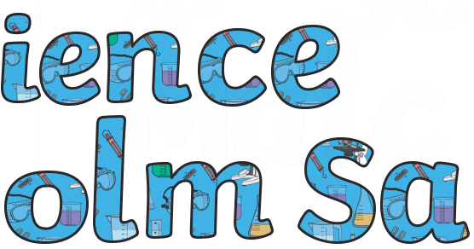
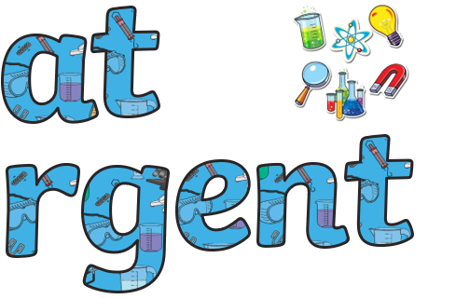



Children are encouraged to use their own curiosity
Children are engaged in purposeful practical work
Children’s Science learning is challenging for all
Science is good when…
Planning is well sequenced and ‘why this, why now?’ is clear
Teachers have secure subject knowledge
Relevant equipment is readily available

